Slide 1


MAHATMA GANDHI INSTITUTE OF TECHNOLOGY
DEPARTMENT OF INFORMATION TECHNOLOGY
An Industry Oriented Mini Project(IT653PC)
on
PDF VOICE : AI-POWERED PDF INTO SPEECH CONVERTER WITH CUSTOMIZABLE AUDIO SETTINGS USING MERN STACK
by
C.vaishnavi -22261A1214
P.Jayacharan-22261A1247
Batch ID:IT-25-27
Internal Supervisor
IOMP Supervisor
Dr.N.SreeDivya
Dr.U.Chaitanya
Assistant Professor
Assistant Professor

Slide 2

CONTENT
1.ABSTRACT
2.INTRODUCTION
3. EXIXTING SYSTEM
4.PROPOSED SYSTEM
5.APPLICATION
6.SOFTWARE REQUIREMENTS & HARDWARE REQUIREMENTS
7..LITERATURE SURVEY
8.PROBLEM STATEMENT
9.ALGORITHM
10.OBJECTIVES
11.MODULES DESCRIPTIONS
12.METHODOLOGY
13.DESIGN ARCHITECTURE & UML DAIGRAMS
14.CODE EXECUTION /RESULTS SCREENSHORTS
15.TEST CASES
16.CONCLUSION
17.REFERENCES

Slide 3



PDF Voice is a web app that converts PDFs into high- quality speech using AI-driven TTS. Built on the MERN stack, it integrates OCR for text extraction, supports multilingual translation, and allows audio customization. Leveraging Google Wave Net, VITS, and SSML, it delivers natural speech with adjustable settings. Users can download the audio for offline use, making it ideal for accessibility and hands-free reading.
ABSTRACT

Slide 4

INTRODUCTION
PDF Voice: AI-Powered MERN Stack PDF to Speech Converter addresses accessibility challenges for visually impaired users and auditory learners by converting PDF documents into high-quality speech.
Key features:
Uses AI, OCR, NLP, and deep learning-based TTS models for natural speech synthesis.
Built on the MERN stack (MongoDB, Express.js, React.js, Node.js) for seamless user experience.
.Users can upload PDFs, select a language, adjust audio settings (volume, pitch), and download speech files.
Includes language detection, automatic translation, and AI-based text extraction for efficient speech generation.
Leverages Google Wavenet, VITS, and SSML to enhance speech clarity and natural phase.

Slide 5



EXISTING SYSYTEM
Natural Reader:
Overview: A text-to-speech software that reads PDF documents, Word files,
and web pages aloud.
Converts documents into speech with natural-sounding voices.
Supports various languages and voice customizations (speed, pitch, etc.). Offers online and offline versions for both personal and professional use.
Target Audience: Visually impaired individuals
CONT...

Slide 6


Read Aloud (Chrome Extension) :
Overview: A browser extension that converts text on web
pages, including PDF files, into speech. Features:
Reads PDF and web content aloud.
Customizable voice settings and languages. Simple interface, accessible for any web user.
Target Audience: General users, including those with visual
impairments and those who prefer auditory learning.

Slide 7


PROPOSED SYSTEM
The proposed system is an AI-powered, offline-capable TTS solution with customizable voices, real-time translation, and interactive voice commands. It supports multiple formats (PDF, Word, EPUB, etc.), works cross-platform (desktop, mobile, browser), and offers AI-based pronunciation learning for a natural speech experience.
Advantages:
Works Offline – No internet required, ensuring privacy and accessibility.
AI-Based Pronunciation – Learns and adapts to accents for improved clarity.
Cross-Platform Support – Available on desktop, mobile, and web.

Slide 8
4.Customizable Voices – Adjust tone, pitch, speed, and emotion.
5.Multi-Format Compatibility – Reads PDF, Word, scanned text, and web pages accurately. 6.Real-Time Translation & Speech-to-Text – Supports multiple languages.
7.Interactive Voice Commands – Hands-free control for enhanced accessibility.
8.AI Voice Cloning – Create personalized AI-generated voices. 9.Lightweight & Fast – Optimized for performance on all devices.
10.Affordable & Ad-Free – Free core features with budget-friendly premium options

Slide 9



APPLICATIONS
Education and E-Learning
Accessible Reading for the Visually Impaired
Audiobook Creation
Corporate Reports and Professional Documents
Language Learning
Content for Podcasts or Audio Platforms

Slide 10


SOFTWARE REQUIREMENTS
OS: Windows, macOS, or Linux
Backend: Node.js, Express.js, MongoDB
Frontend: React.js
AI/ML: Text-to-Speech (TTS) APIs, OCR engines, NLP models
Additional Tools: SSML for speech clarity, Cloud APIs (Google Cloud, AWS, Azure) for text extraction & translation

Slide 11

HARDWARE REQUIREMENTS
Minimum 4GB RAM
Dual-core processor
Stable internet connection
SSD (Solid-State Drive) for faster data retrieval and processing
Microphone and speakers

Slide 12
LITERATURE SURVEY
S.NO | AUTHOR NAMES, YEAR OF PUBLICATION | JOURNAL OR CONFERENCE NAME AND PUBLISHER NAME | METHODOLOGY/ ALGORITHM / TECHNIQUES USED | MERITS | DEMERITS | RESEARCH GAPS
1 | Wang et al., (2023) | IEEE Access | Multilingual Transformer-based OCR and TTS pipeline | Supports multiple languages; improved contextual accuracy | Requires large memory footprint | Lacks optimization for embedded systems
2 | Tan & Ibrahim (2023) | Elsevier – Pattern Recognition Letters | Lightweight OCR with Vision Transformers (ViT) | High efficiency on edge devices | Slight drop in accuracy compared to larger models | Requires better handling of stylized fonts in PDFs

Slide 13
3 | Nguyen et al., (2023) | ACM Multimedia | Real-time TTS using diffusion models | Produces natural and expressive speech | Training requires significant compute | Needs faster inference for real-time mobile use
4 | Chakraborty & Singh (2023) | MDPI Electronics | End-to-end OCR-TTS pipeline with self-supervised pretraining | Reduces need for labeled data; scalable | Performance drop on low-resource languages | Limited multilingual pretraining resources
5 | Ahmed et al., (2023) | Wiley -Expert Systemss | Context-aware PDF reader with AI-based voice personalization | Persona;ized and dynamic audio output | High latency on older devices | Optimization needed for real-time personalization

Slide 14

PROBLEM STATEMENT
Many individuals, especially those with visual impairments or reading difficulties, struggle to access and consume information from PDFs. Existing solutions for text-to-speech are often limited in customization, making it difficult to tailor the experience to individual preferences.

Slide 15
Algorithm
Step 1: Upload PDF
React form with <input type="file" accept="application/pdf" />
On submit, send file using FormData via POST request to /api/upload
.
Step 2: Extract Text from PDF
Use pdf-parse in Node.js
Step 3: Convert Text to Speech
Use a TTS API. Example Google Cloud TTS
Save audio file locally or upload to cloud storage.
Step 4: Serve Audio File
Save the audio file (e.g., output.mp3) and serve it via a static route.
Return the URL of the audio file to the frontend.
Step 5: Play Audio in React

Slide 16

OBJECTIVES
1.If it needed langauge can be chaged into:
1.English
2.Spanish
3.French
4.Italian
2.We can save the audio if needed.
3.The audio playback speed can be changed as low speed or high speed like 2x ,1.5x..

Slide 17
MODULES DESCRIPTION
PDF Upload – Upload and extract text from PDFs. Text-to-Speech – Convert text to speech using AI.
Audio Customization – Adjust voice, pitch, and speed. Playback – Stream converted audio with controls.
User Preferences – Save settings for future use. Database – Store user data and PDFs.

Slide 18
METHODOLOGY
User Interface: Upload PDF, adjust settings.
Backend: Extract text, convert to speech.
Customization: Adjust voice, pitch, speed.
Playback: Stream audio with controls.
Database: Store user data and preferences.

Slide 19

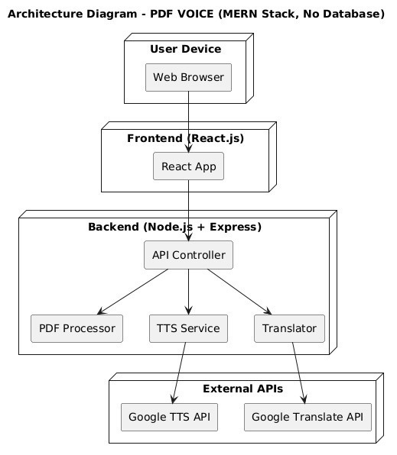
Architecture Design

Slide 20
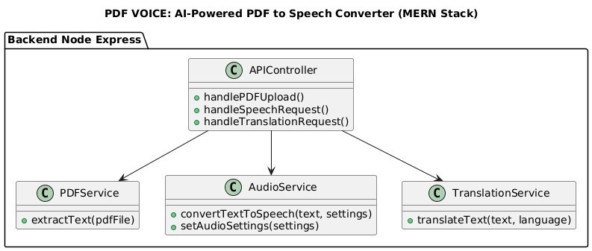
UML DIAGRAMS
Class Diagram:

Slide 21
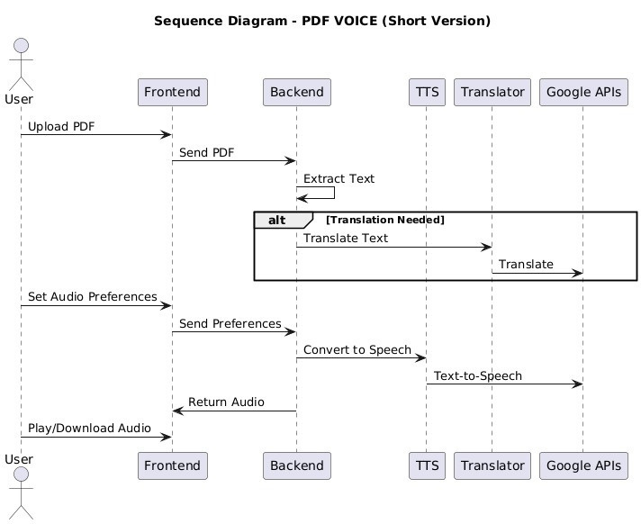
Sequence diagram :

Slide 22
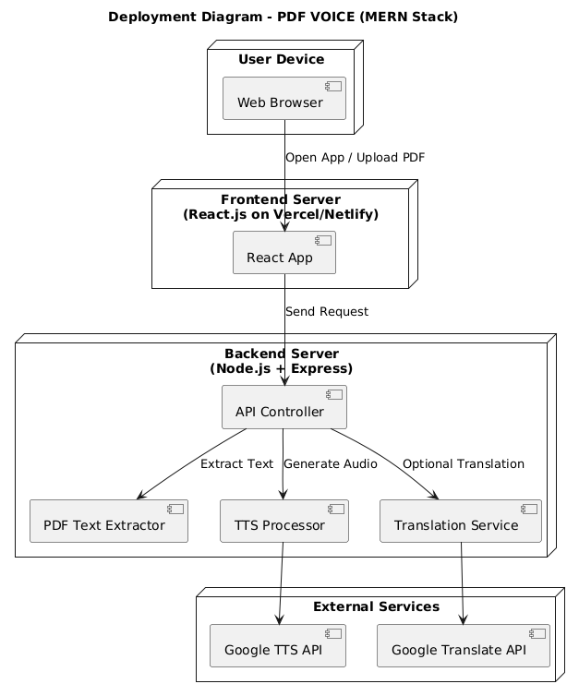
Deployment diagram :

Slide 23
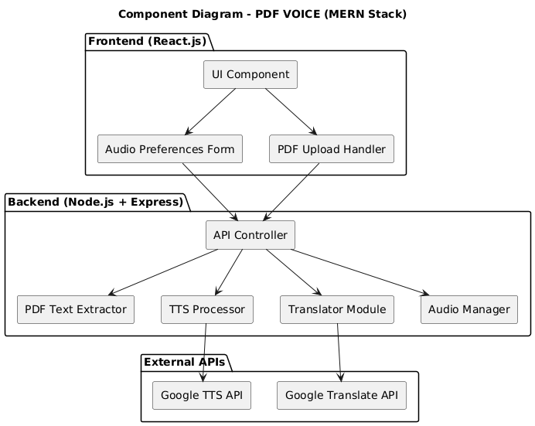
Component diagram :

Slide 24
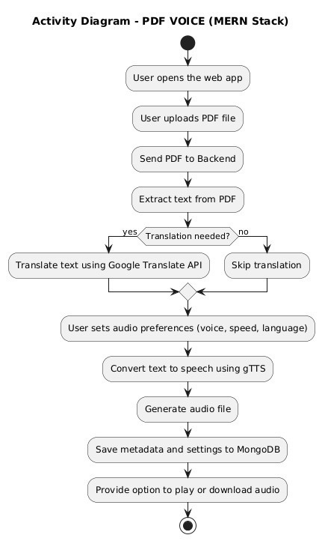
Activity diagram :

Slide 25

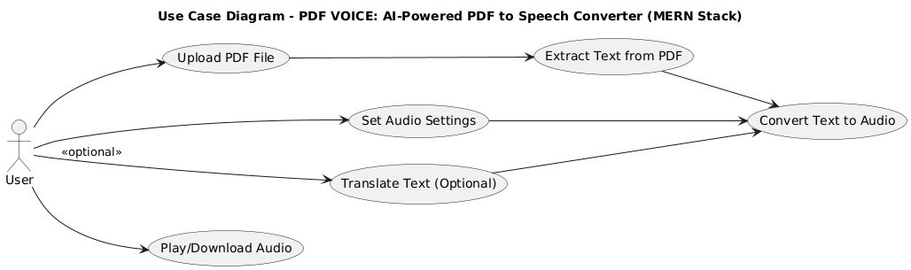
Usecase diagram :

Slide 26
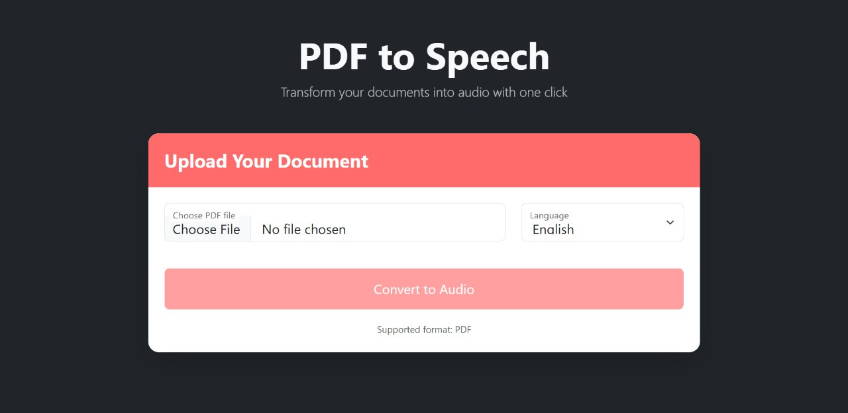
RESULTS
1.select the file to upload

Slide 27
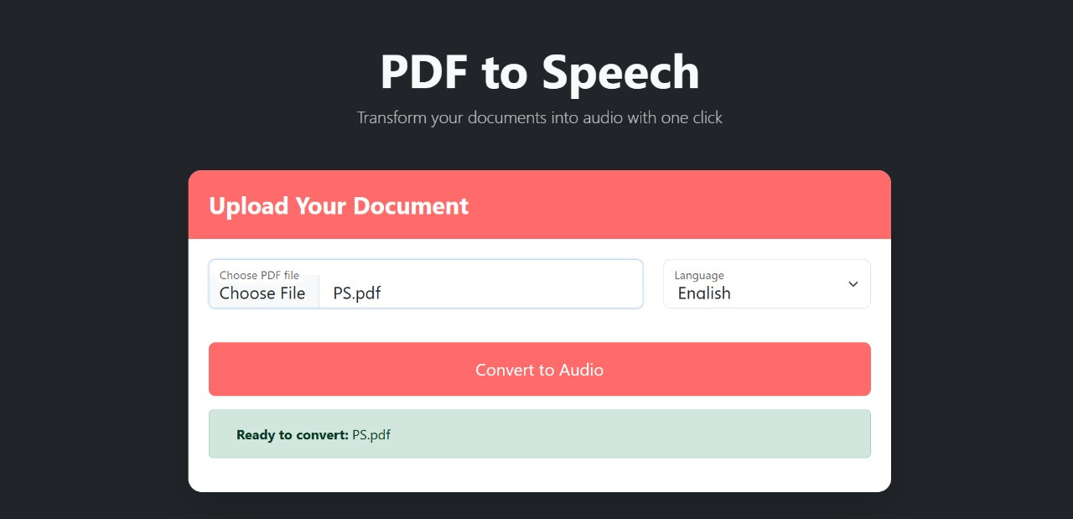
2.uploading of file

Slide 28
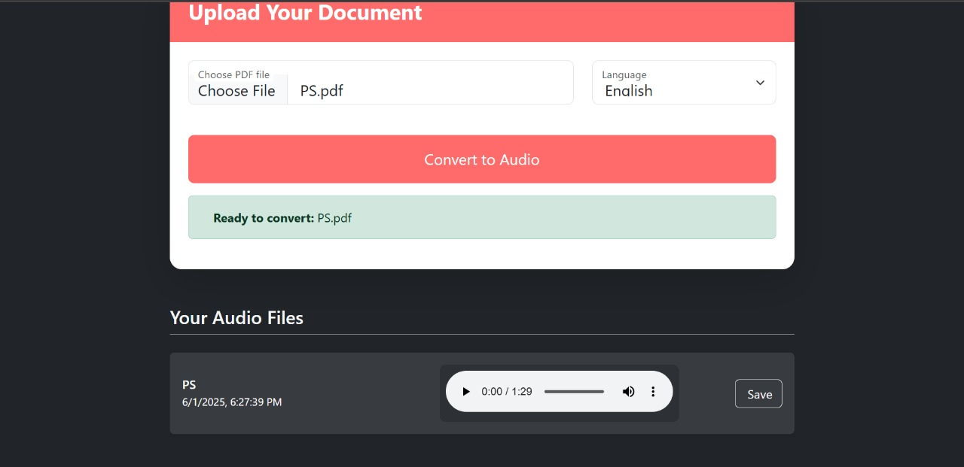
3.Select the langauge

Slide 29
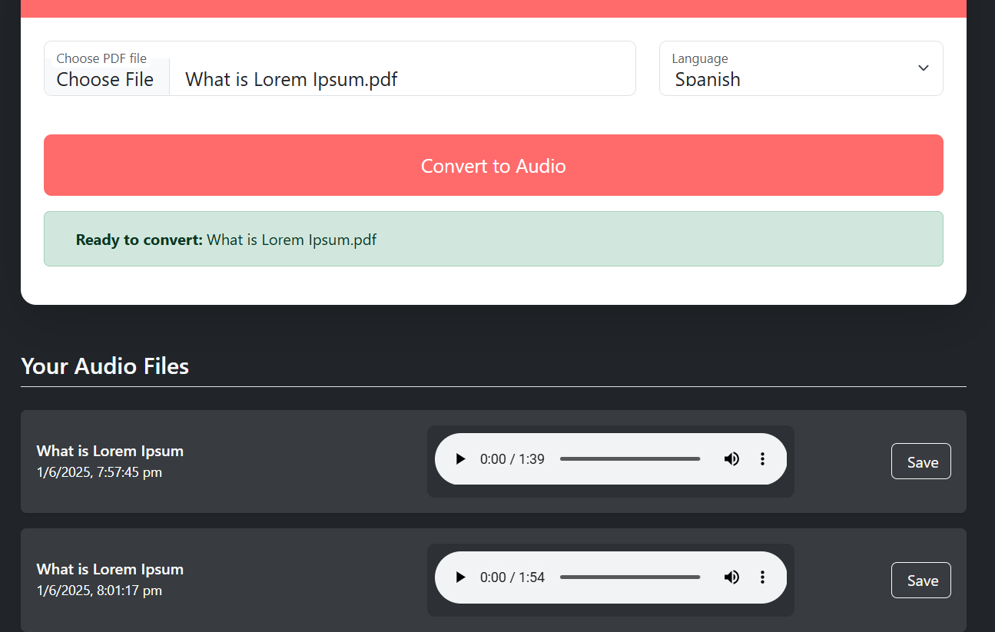
4.Select to convert audio

Slide 30

5.The file is converted and listen or save it,and
set your audio settings if needed

Slide 31
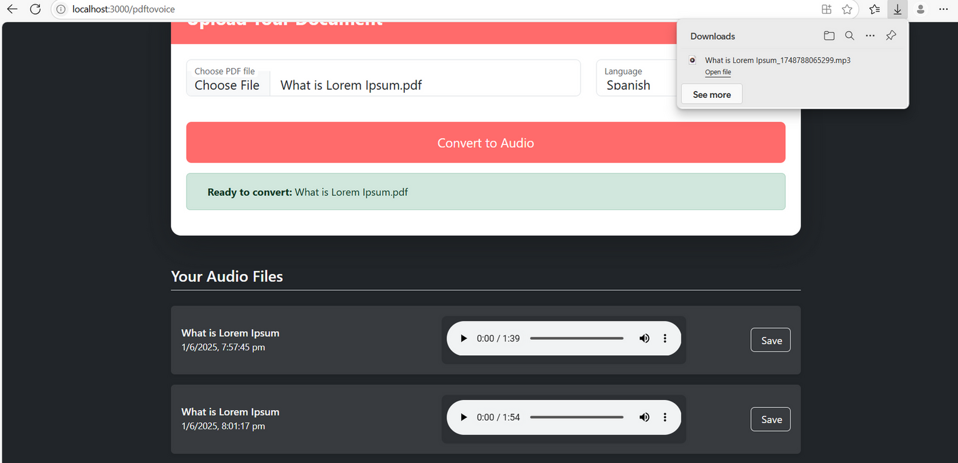

6.Select the download option if needed

Slide 32
Testcases
Test Case ID | Test Scenario | Input | Expected Output
TC01 | Check if the PDF file has been successfully uploaded | Upload a valid PDF file | PDF file uploaded successfully and accepted by system.
TC02 | Verify audio file generation after PDF upload | Upload a valid PDF file | Audio file generated successfully.
TC03 | Display time when audio file was generated | Upload a valid PDF file | Time of audio generation displayed on screen.
TC04 | Display time of audio file generation | Upload a valid PDF file | The time when the audio file is generated is displayed to the user.
TC05 | Save the generated audio file | Upload a valid PDF file | The user can save the audio file to their device.

Slide 33

CONCLUSION
The PDF-to-Voice Converter makes PDF content accessible by converting it into customizable audio. It provides essential features like text extraction, voice adjustment, and playback control, benefiting users with visual impairments or reading challenges. The system can be further enhanced with multi-language support and more customization options in the future.

Slide 34
References
Wang et al., “Multilingual Transformer-based OCR and TTS pipeline,” IEEE Access, 2023.
Tan & Ibrahim, “Lightweight OCR with Vision Transformers (ViT),” Elsevier – Pattern Recognition Letters, 2023.
Nguyen et al., “Real-time TTS using diffusion models,” ACM Multimedia, 2023.
Chakraborty & Singh, “End-to-end OCR-TTS pipeline with self-supervised pretraining,” MDPI Electronics, 2023.
Ahmed et al., “Context-aware PDF reader with AI-based voice personalization,” Wiley - Expert Systems, 2023.
Link:
https://github.com/jc-710/PDFVoice

Slide 35



